Slide 1


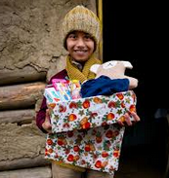
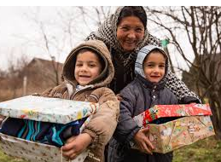
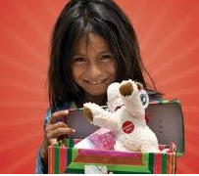
Christmas in a Shoebox 2019

Slide 2

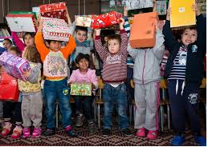
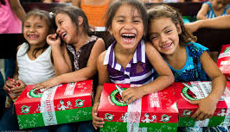
Christmas in a shoebox
Purpose
The world’s largest Christmas project of its kind, Operation Christmas Child, uses gift-filled shoeboxes to demonstrate God’s love in a tangible way to children in need around the world.

Slide 3
Scope
Since 1993, the Samaritan’s Purse project, Operation Christmas Child, has collected and delivered more than 135 million gift-filled shoeboxes to children in more than 150 countries and territories.
Shoebox gifts are collected in the U.S., Australia, Finland, Germany, Austria, Switzerland, Japan, New Zealand, Canada, Spain, and the U.K.
More than 500,000 volunteers worldwide are involved in collecting, shipping, and distributing shoebox gifts.

Slide 4
Process
Individuals, families, churches and groups fill empty shoeboxes with a “wow” item—like a doll or soccer ball—and other fun toys, school supplies, hygiene items, and notes of encouragement
Samaritan’s Purse/Geschenke der Hoffnung and its partners will deliver the gifts to children in more than 100 countries.

Slide 5
Christmas in Shoebox
- Luxembourg
We are all volunteers living in and around Luxembourg that like to bring hope and love to needy children.
We deliver our checked and sealed boxes to Trier by the second week in November. Trier is the closest collection point of the umbrella organisation of ‘Geschenke der Hoffnung’ in Germany, of which Weihnachten im Schuhkarton’ (translated ‘Christmas in a shoebox’) is one of their biggest projects annually. Their collection point in Trier takes on the responsibility for the logistics of transportation and
distribution as part of the broader project in German speaking countries.
Our boxes will be distributed in Romania and Moldova, normally
before Christmas this year. Receiver countries are divided up
according to postal codes in Germany to ensure that the boxes are
distributed to as many communities as possible.
We are part of the global Samaritan’s Purse vision that has been
providing spiritual and physical aid to hurting people around the
world since 1970.
For more info on our team: http://christmasshoebox-luxembourg.com/about/

Slide 6
Christmas in Shoebox - Results
Last year the Luxembourg team collected 1.700 boxes, 455 of which where collected through our International English-speaking community of the Parish of Luxembourg Notre Dame.
A huge thank you to all who have contributed last year
A huge challenge to see how well we can do this year ! ?

Slide 7
Are you joining us?
Do you want to help by:
  packing a box
  donating the contents for a box
  ‘buying’ a packed box
  donating some money towards the transport of the boxes
  Take a look at our packing list (also on catholic.lu) to see what goes into a Christmas Shoebox or contact Michele Rohen from our parish if you would prefer to sponsor a pre-packed box ( + - 30 Euro)

Slide 8
What to pack
Winter Clothing: Scarf/gloves/hat/socks
Toy: Cuddly toy/ Cars/dolls/Lego /balls/ football with pump/ Board game (travel size)
Hygiene Items: Toothbrush & toothpaste / Facecloth & non-perfumed soap (soap must be packed in a small plastic bag)
School items: Pencil case, markers, pencils, colours / A5 exercise book
Chocolate / sweets (exp date > 03.2019): Plain milk chocolate (No nuts or fillings) /Sucking and chewing sweets (No GELATINE !!!)
Personal Card/letter
*€10 Euros in an envelope - the money covers transportation costs and will be taken out of the box
ALL ITEMS MUST BE NEW

Slide 9
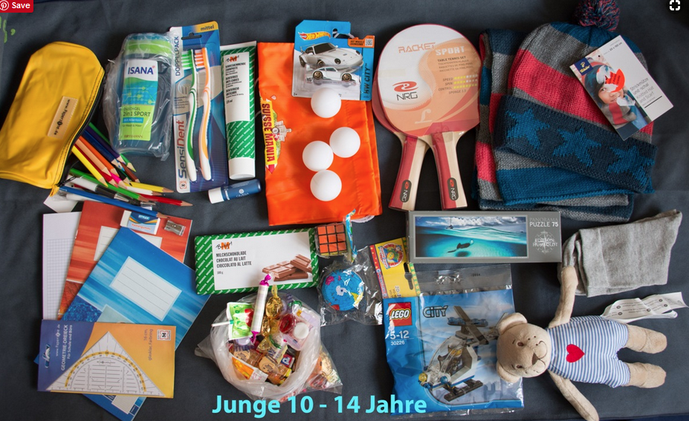
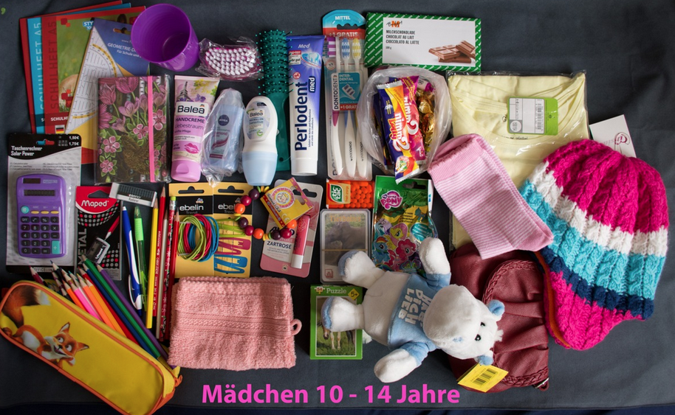
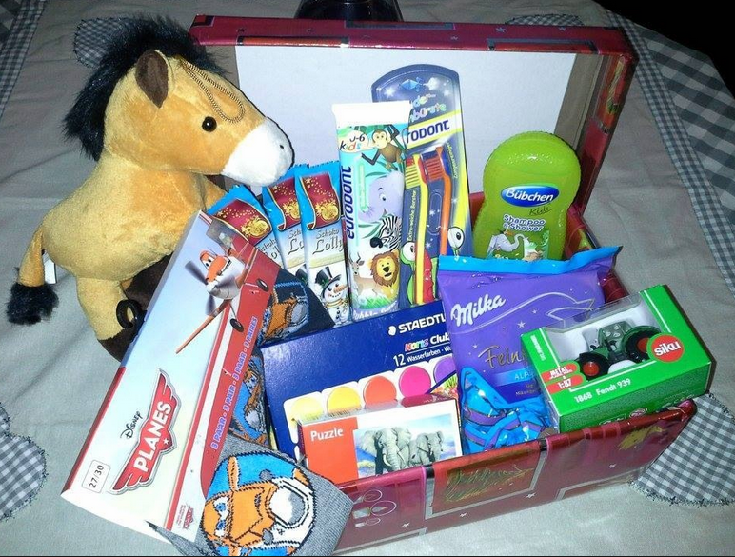
Sample shoebox contents

Slide 10
Practical information
You can obtain standard flatboxes (free of charge) to fill at the back of the church after each English speaking mass from Sep 28 – October 27 2019.
Pre-packed boxes are also available to ‘buy’ after mass for 30 Euro/box . You will simply be asked to write a little card to personalize the box you chose. (every single box we pre-pack is unique !)
You can submit your packed box before or after any of the English speaking masses in October.
Final submission deadline is October 27 2019 !

